Slide 1
An AI-assisted decision making system for thyroid nodule classification
Concept Presentation

Slide 2
The Motive
The dominant way of determining the category of a thyroid module is a Fine Needle Aspiration (FNA) biopsy
An FNA procedure is a process involving
Experienced doctors and expensive labs is an expensive resource
Can we have an inexpensive process to determine if a specific patient should perform FNA or not?
Yes, With the help of Image Analysis and Artificial intelligence

Slide 3
The Application
The details of the process involved and the methodologies are still under active research; today we
I will present you with the interface of this application with the intent of getting useful feedback.

Slide 4
The Application
At the current stage using DDTI and TDID datasets and a simple C-Support Vector Classification, we have a success rate of ~80%. The current state of the project involves the combination of multiple different prediction techniques and image filters to the scans, and the study of their affect on the success rate.

Slide 5
The proccess
The application, from an operators perspective, will have
The following workflow
Log in to the system
Navigate into the relevant menu
Upload a scan of a known patient
Submit a ‘Prediction Task’ into the system
Wait for a couple of seconds, as its task is scheduled to be completed on a First-Come-First-Serve basis
View the results, a prediction(TIRADS Classification) , and possibly some useful statistics about the scan
The radiologists will have the option to agree or disagree with the prediction by writing a short paragraph and submitting it for our team to use as a feedback loop for improvement

Slide 6
The proccess
Additionally , Doctors could save the results for later use, and associate a scan with a patient, possibly comparing multiple scans from different time periods, in order to determine the progress of this specific patient
Suggestions for additional features that can make the workflow of doctors easier are, of course, welcome

Slide 7
The Interface
Additionally , Doctors could save the results for later use, and associate a scan with a patient, possibly comparing multiple scans from different time periods, in order to determine the progress of this specific patient
Suggestions for additional features that can make the workflow of doctors easier are, of course, welcome

Slide 8
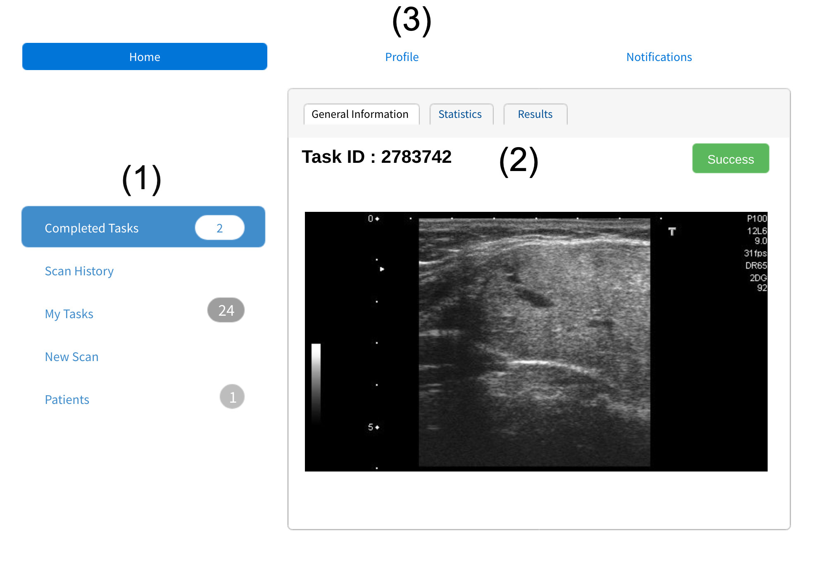
The Interface
Action Area. The Area that a doctor will perform a new action, such as uploading a new scan and submitting a new task to the system
(2) The information area contains the information selected by a particular action. In this scenario, a completed task shows its results
(3) The System Information Area may be used by used to extract useful info about the current state of the system

Slide 9
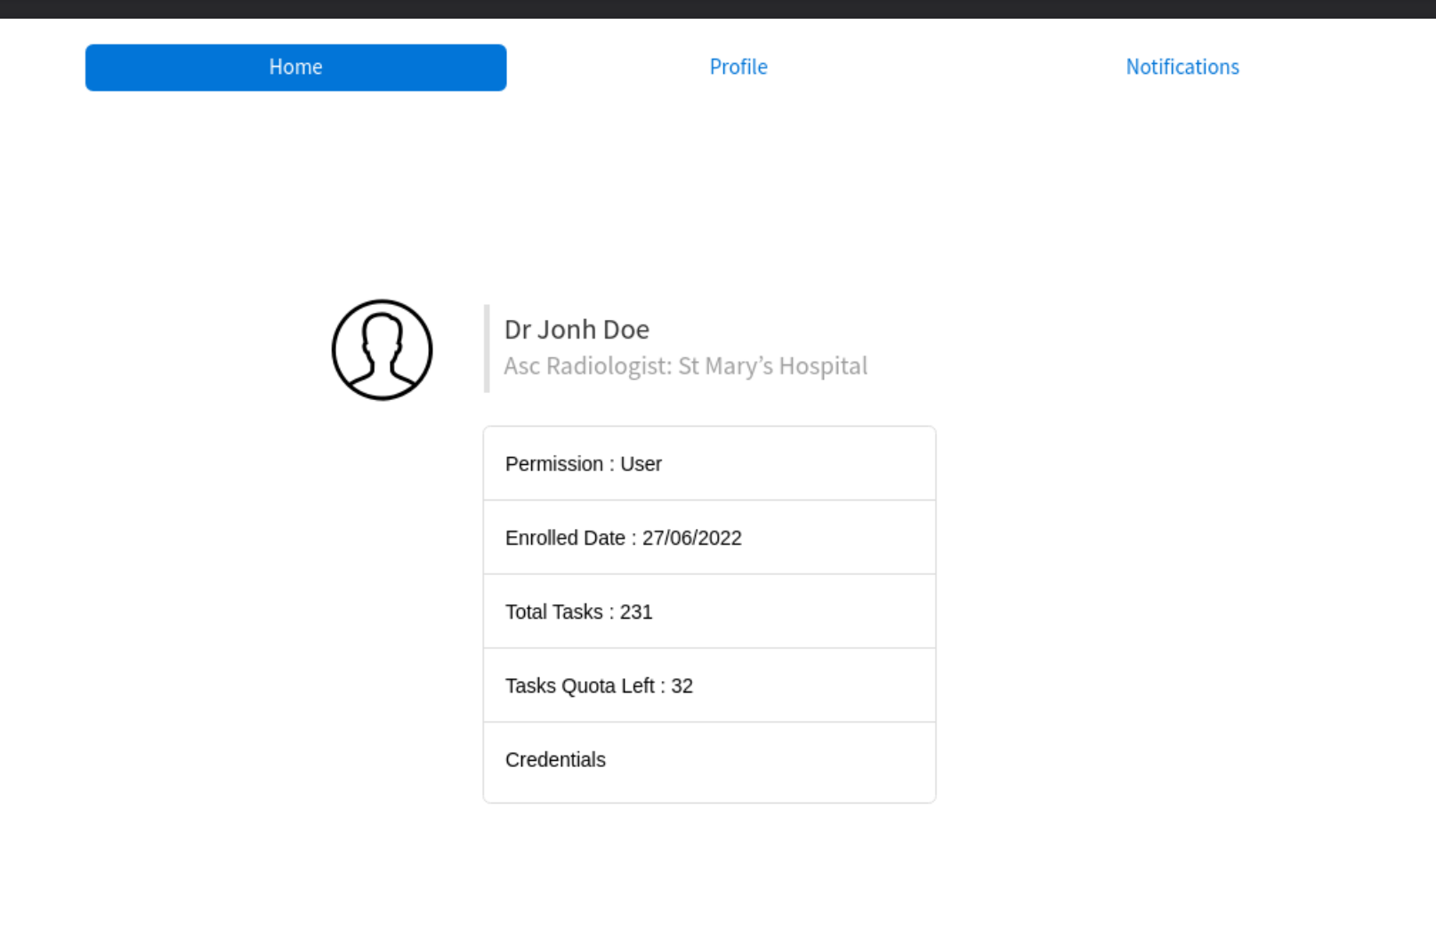
The Interface
User Information Area. Various useful information regarding the user can be found here, such as the total tasks, tasks quota, name, and permission information

Slide 10
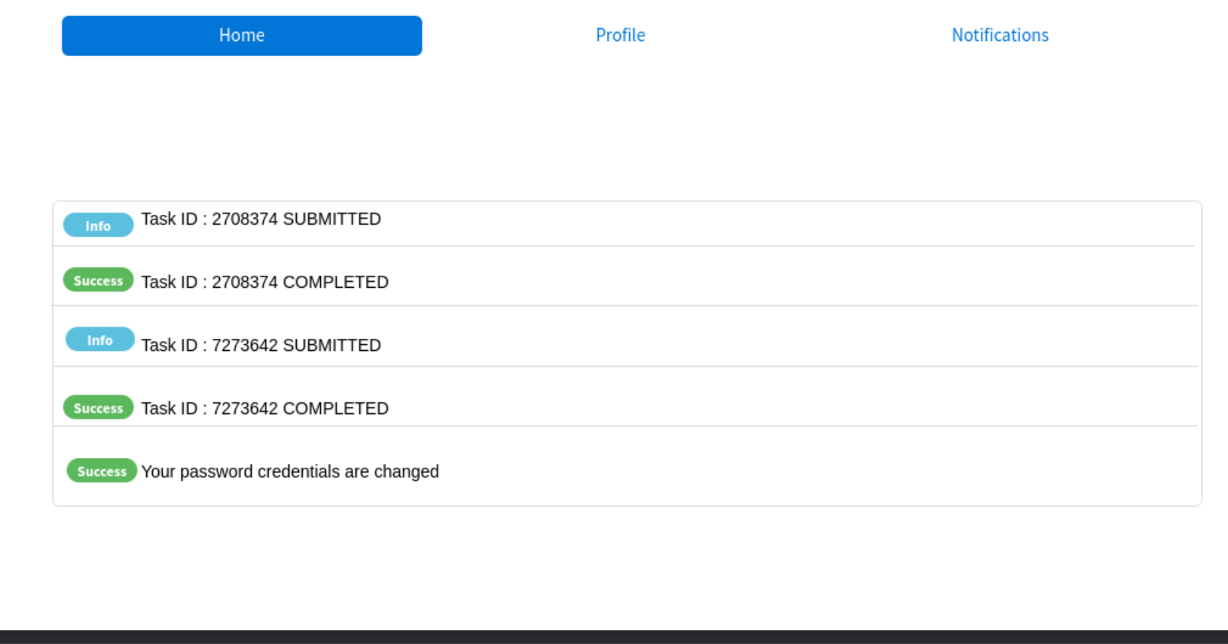
The Interface
User Notification Area. From this are the user may be informed about the progress of their submitted tasks as well as the system status

Slide 11
Feedback
We would like to hear about the UI structure, features, and possible additions and statistics that may be of interest to the doctors
Stefanos Stefanou, Undergraduate Computer Scientist, University of Reading UK.
Thank you

